Slide 1
Cougaar Test Framework

Slide 2
Goals
Provide some level of automated testing for plugins
No requirement to modify original plugin source code
Maintain the original cougaar environment as much as possible

Slide 3
General Approach
Develop methodology for defining valid agent behavior
Automate validation methodology
Report results

Slide 4
Validation Methodology
Plug-ins define the behavior of an agent
There are several different aspects to plug-ins behavior
  Internal functional logic
  External interactions (e.g., databases)
  Service Level Interactions
    Blackboard interactions

Slide 5
Internal Functional Logic
Method-level validation
Use of JUnit where possible

Slide 6
External Interactions
Access to other systems outside the scope of the agent
Examples: SQL queries, LDAP queries, HTTP requests
Require some specialized validation mechanism depending on the external source

Slide 7
Service Level Interactions
A Plug-in’s interaction with other Cougaar services
Blackboard Service is the primary service we’re concerned with

Slide 8
Blackboard Interactions
Specific Service Level Interaction
Defined by the Add, Change, and Remove actions published by a plug-in against the blackboard
These actions can be initiated by the plug-in or can be a reaction to other blackboard events
To the extent that the validity of a plug-in can be defined by it’s blackboard interactions, we can automate the testing of that plug-in

Slide 9
Blackboard Interaction Validation
Requires ability to capture the state of the plug-in’s blackboard activity over time
Requires ability to define the expected blackboard interaction state
Requires ability to compare expected and actual blackboard interaction states

Slide 10
Reporting
Test Results
  For each assertion there is an associated result
  Result includes:
    Id
    Test Phase (i.e., subscription or execution)
    Command (i.e., subscription, add, change, remove)
    Result (i.e., pass or fail)
    Description

Slide 11
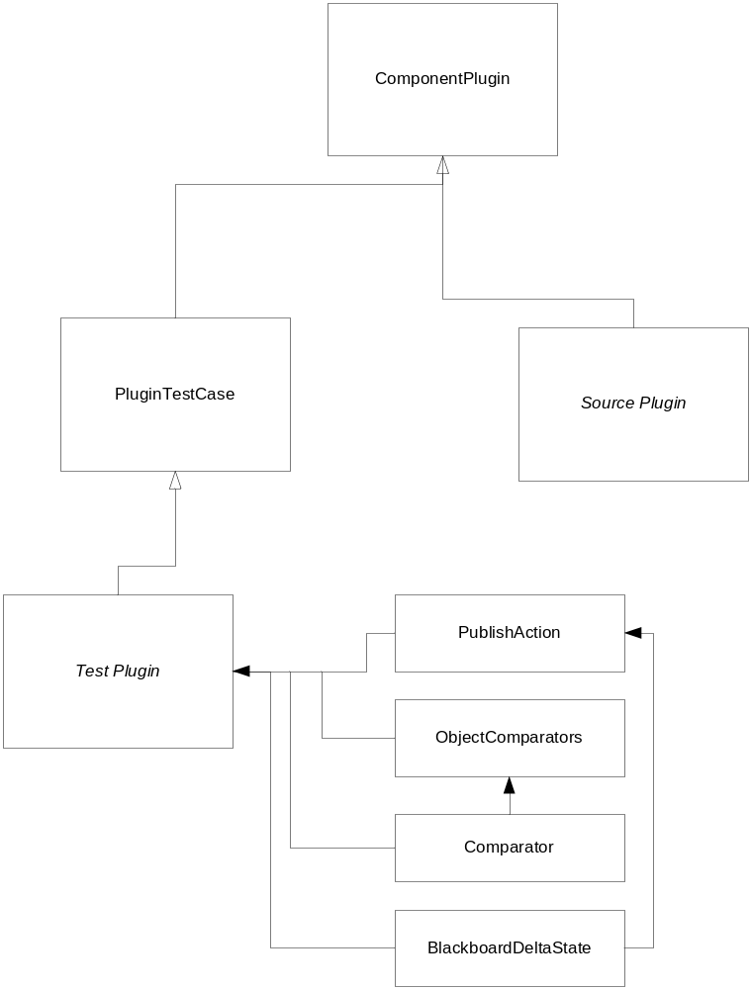
External Architecture

Slide 12
External Architecture
2 essential components
  Source plugin
  Test Plugin
TestPlugin requires use of the following objects:
  BlackboardDeltaState
  PublishAction
  Comparator (singleton class)
  Comparator

Slide 13
External Architecture
PluginTestCase
3 methods need to be implemented in the Test Plugin
  getPluginClass()
    Presents the id of the source plugin to the testing infastructure
  validateSubscriptions()
    Use of the assertSubscription() method to validate unary predicates in the source plugin
  validateExecution()
    Use of the assertPublishAdd(), assertPublishChange(), and assertPublishRemove() methods to validate the execution block of the source plugin

Slide 14
BlackboardDeltaState
Key component for execution tests
Represents the state of the source plugin’s blackboard interactions over a set period of time
Requires defining a series of PublishActions

Slide 15
PublishAction
Defines the action id
  ADD, CHANGE, or REMOVE
Defines the target Object
Uses Comparator objects for determining equality

Slide 16
Comparators
Used for comparing PublishAction objects
Registered with the ObjectComparators singleton
Default Comparator compares classes
Any object Comparator can be registered within the validateExecution() method

Slide 17
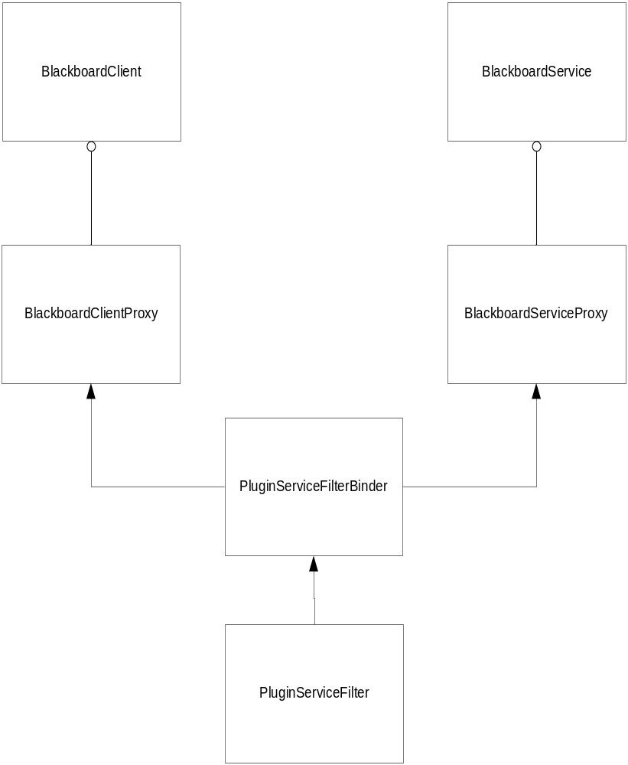
Internal Architecture

Slide 18
Internal Architecture
PluginServiceFilter registers two proxies
  BlackboardServiceProxy is used to proxy the source plugin blackboard activity to the Cougaar infastructure so it can be captured for testing purposes
  BlackboardClientProxy is used to determine when the source and test plugin are loaded so testing can start.

Slide 19
Starting the Test Framework
Java command line
java -classpath c:\cougaar941\lib\test\CougaarUnit.jar;c:\cougaar941\lib\core.jar;c:\cougaar941\lib\util.jar org.cougaar.plugin.test.Launcher org.cougaar.plugin.test.sample.TestPluginSample

Slide 20
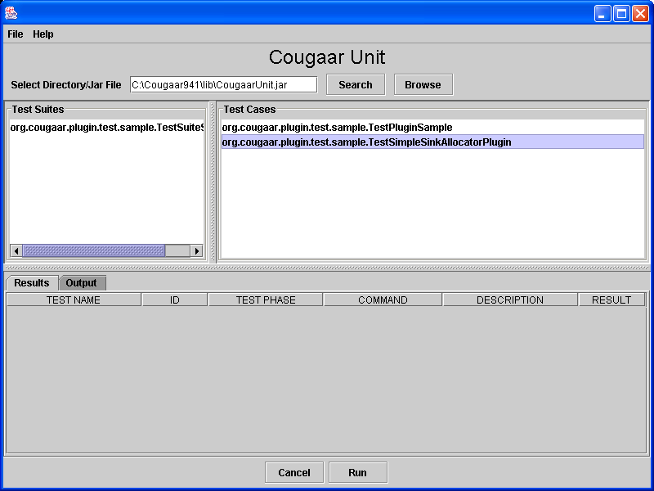
Graphical UI

Slide 21
Example
PluginSample
public class SamplePlugin extends ComponentPlugin {
private IncrementalSubscription testIS;
UnaryPredicate testUP = new UnaryPredicate() {
public boolean execute (Object o) {
if (o instanceof TestBBMessageObject)
return true;
return false;
}
};;
protected void setupSubscriptions() {
testIS = (IncrementalSubscription)getBlackboardService().subscribe(testUP);
}
protected void execute() {
Collection messages = testIS.getAddedCollection();
if (!messages.isEmpty()) {
for (Iterator iter=messages.iterator(); iter.hasNext(); ) {
System.out.println("added: " + iter.next());
}
getBlackboardService().publishAdd(new TestBBMessageObject2());
}
messages = testIS.getChangedCollection();
if (!messages.isEmpty()) {
for (Iterator iter=messages.iterator(); iter.hasNext(); ) {
System.out.println("changed: " + iter.next());
}
getBlackboardService().publishAdd(new TestBBMessageObject3());
}
messages = testIS.getRemovedCollection();
if (!messages.isEmpty()) {
for (Iterator iter=messages.iterator(); iter.hasNext(); ) {
System.out.println("removed: " + iter.next());
}
getBlackboardService().publishAdd(new TestBBMessageObject4());
}
}
}

Slide 22
Example
TestPluginSample
public class TestPluginSample extends PluginTestCase {
public void validateSubscriptions() {
subscriptionAssert(new TestBBMessageObject(), true);
subscriptionAssert(new TestBBMessageObject2(), false);
}
public void validateExecution() {
BlackboardDeltaState bbs = new BlackboardDeltaState();
bbs.add(new PublishAction(PublishAction.ADD, new TestBBMessageObject2()));
assertPublishAdd(new TestBBMessageObject(), bbs, 5000, true, false);
}
public String getPluginClass() {
return "org.cougaar.plugin.test.sample.SamplePlugin";
}
}

Slide 23
Example
Output
<?xml version="1.0"?>
<TEST Name="org.cougaar.plugin.test.sample.TestPluginSample">
<ID Value="1">
<PHASE>SUBSCRIPTION</PHASE>
<COMMAND>SUBSCRIPTION ASSERT</COMMAND>
<DESCRIPTION>org.cougaar.plugin.test.sample.TestBBMessageObject</DESCRIPTION>
<RESULT>pass</RESULT>
</ID>
<ID Value="2">
<PHASE>SUBSCRIPTION</PHASE>
<COMMAND>SUBSCRIPTION ASSERT</COMMAND>
<DESCRIPTION>org.cougaar.plugin.test.sample.TestBBMessageObject2</DESCRIPTION>
<RESULT>pass</RESULT>
</ID>
<ID Value="3">
<PHASE>EXECUTION</PHASE>
<COMMAND>PUBLISH ADD</COMMAND>
<DESCRIPTION>org.cougaar.plugin.test.sample.TestBBMessageObject</DESCRIPTION>
<RESULT>pass</RESULT>

Slide 24
Example
Output
<EXPECTED_STATE>
<BLACKBOARD_DELTA_STATE>
<PUBLISH_ACTION>
<ACTION_ID>ADD</ACTION_ID>
<RESULT>org.cougaar.plugin.test.sample.TestBBMessageObject2</RESULT>
</PUBLISH_ACTION>
</BLACKBOARD_DELTA_STATE>
</EXPECTED_STATE>
<ACTUAL_STATE>
<BLACKBOARD_DELTA_STATE>
<PUBLISH_ACTION>
<ACTION_ID>ADD</ACTION_ID>
<RESULT>org.cougaar.plugin.test.sample.TestBBMessageObject2</RESULT>
</PUBLISH_ACTION>
</BLACKBOARD_DELTA_STATE>
</ACTUAL_STATE>
</ID>
</TEST>

Slide 25
Another Example
public class TestSimpleSinkAllocatorPlugin extends PluginTestCase {
private DomainService domainService = null;
public void setDomainService(DomainService aDomainService) {
domainService = aDomainService;
}
public String getPluginClass() {
return "org.cougaar.core.examples.SimpleSinkAllocatorPlugin";
}
public void validateSubscriptions() {
NewTask new_task = domainService.getFactory().newTask();
this.subscriptionAssert(new_task, true);
this.subscriptionAssert(new Object(), false);
}
public void validateExecution() {
  NewTask newTask = domainService.getFactory().newTask();
newTask.setVerb(new Verb("Random Verb"));
newTask.setPlan(domainService.getFactory().getRealityPlan());
ScoringFunction scorefcn = ScoringFunction.createStrictlyAtValue(new AspectValue(AspectType.START_TIME, 1));
ScoringFunction scorefcn2 = ScoringFunction.createStrictlyAtValue(new AspectValue(AspectType.END_TIME, 2));
Preference pref = domainService.getFactory().newPreference(AspectType.START_TIME, scorefcn);
Preference pref2 = domainService.getFactory().newPreference(AspectType.END_TIME, scorefcn2);
Vector preferences = new Vector();
preferences.add(pref);
preferences.add(pref2);
blackboard.openTransaction();
newTask.setPreferences(preferences.elements());
blackboard.closeTransaction();
PublishAction pa = new PublishAction(PublishAction.ADD, Allocation.class);
BlackboardDeltaState bds = new BlackboardDeltaState();
bds.add(pa);
this.assertPublishAdd(newTask, bds, 5000, true, false);
}
}

Slide 26
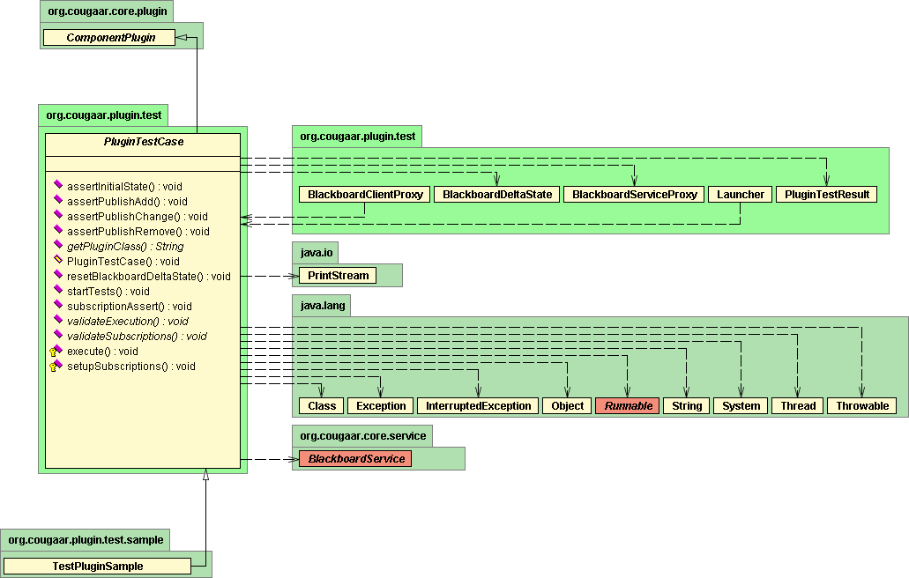
UML Diagrams
(PluginTestCase)

Slide 27
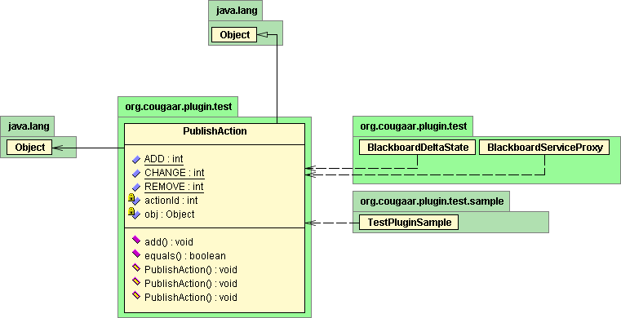
UML Diagrams
(PublishAction)

Slide 28
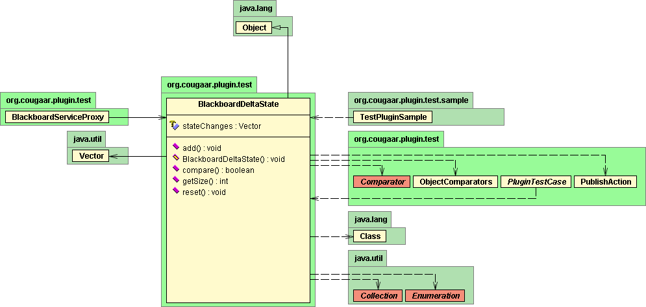
UML Diagrams
(BlackboardDeltaState)

Slide 29
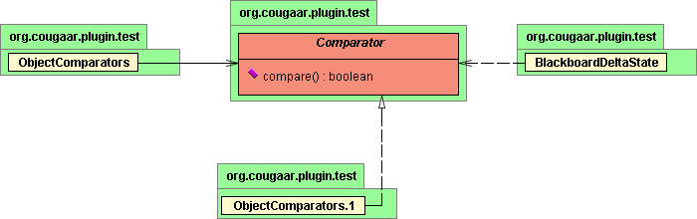
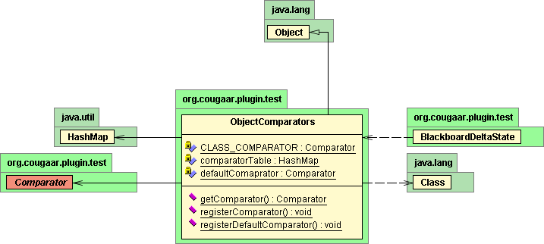
UML Diagrams
(Comparators & ObjectComparators)

Slide 30
UML Diagrams
(BlackboardDeltaState)

